Slide 1

Use comments to predict rating score
Group 3: Nan Yang, Yupei Lin, Sukyoung Cho, Crystal Liu

Slide 2

MLR model
Multiple Linear regression model with 4002 predictors
Predictors:
4000 words selected using TF-IDF
City
log of total number of words (“log(nwords)”)

Slide 3

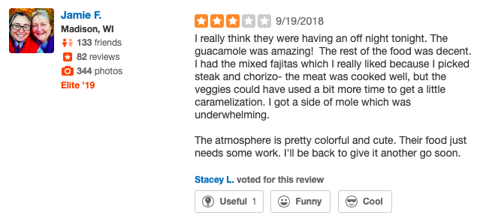
Background

Slide 4
Dataset
85, 543 data
51,326 in training, 34,217 in testing
Data Correction: cities’ names
De Forest & Deforest & DeForest → De Forest
Mc Farland & Mcfarland & McFarland → McFarland
Sun Praiie & Sun Prairie → Sun Prairie

Slide 5

Choose the best predictors
R package for managing and analyzing textual data
Tokenized Word
Phrase extraction (2-word)+choose features
TF-IDF Transformation

Slide 6
Example:
The food for brunch was amazing but yikes...someone must not have shown up. One server and she's working her buns off!
Remove symbols, punctuations, stop words in english
Tokenized
Notes:
Train$text[22]

Slide 7

Example:
Phrase extraction (2-word)
Choose top 4000 features
“good_service” | “not_cool” | “nice_food”
Notes:
Why we did this? Need adjectives to have actual sentiments,

Slide 8
TF- IDF: Term Frequency-Inverse Data Frequency
Review 1 Review 2
this | 1
is | 1
a | 2
stat | 1
course | 1
this | 1
is | 1
another | 2
stat | 3
course | 1
Notes:
The main function of it is to reflect how important each phase/word to the reviews in the total collection or corpus.
Term frequency of word in each review by dividing total number of words in review from times of the word appears in one specific review.
Second, we compute the inverse data frequency by diving number of reviews containing the word from total number of reviews and taking the logarithm of the quotient. So the words that occur rarely in the corpus have a high IDF score.

Slide 9

Transformed Dataframe
 | “see” | “close” | “realli” | “want” | “place”......
text1 | 0.0188 | 0.00739 | 0.00371 | 0.00479 | 0.0043
text2 ……. | 0 ……. | 0 ……. | 0 ……. | 0 ……. | 0 …….
Notes:
We decided to have 4000 words with highest frequencies. Because we wanted get as precise as we could

Slide 10
MLR Model
Predictors (x): 4002
4000 words, log of the number of words, city
Dependent Variable (Y): Star rating

Slide 11
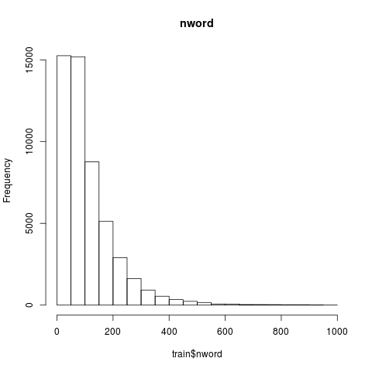
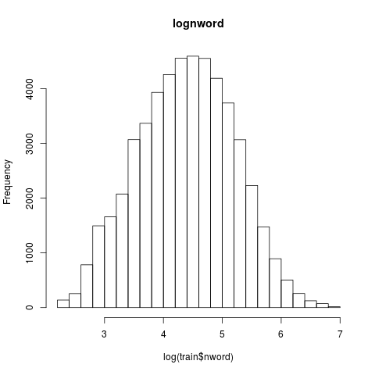

Slide 12
Model coefficients
Intercept(B0) = 11.19
Coefficient interpretation:
Word | Coefficient | P-value ( T-test )
embarrass | -10.400869 | 9.81e-08
never_come | -8.096793 | 6.08e-08
sick | -12.057062 | 2.01e-14
Notes:
These are a few examples from our predictors with huge coefficients.
For the coefficient values, since we use TF-IDF transformation, then we have to treat one unit increase/decrease as one unit transformed value increase/decrease.

Slide 13
Hypothesis test for F-test
H0: all β = 0, Ha: at least one of β is not zero
Reject the null hypothesis !
Degrees of Freedom | F-statistics | p-value
4022, 47303 | 22.91 | < 2.2e-16

Slide 14
Prediction
ID-7795
“Friendly service and very clean. As promised, freaky fast delivery.”
Prediction: 4.56
ID-37940
“The Pad Thai is as fabulous as everyone raves about!”
Prediction: 4.84

Slide 15
Evaluation - Assumptions
Additivity: Reasonable in general. Having more “good” would result in higher star rating.
Constant effects: Reasonable but may not. 49 to 50 number of “good” would not be same as 0 to 1 number of “good”.
Fixed X: This seems reasonable for this data. Nowadays, computers autocorrect the typo - less erroneous.

Slide 16
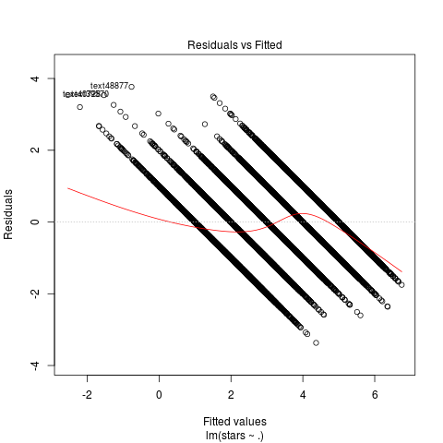
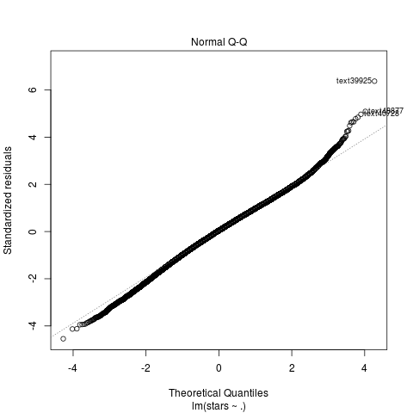
Residual and QQ plots
Notes:
outlier in Y given X (measured using the residual plot)
Linearity: Expected to be violated because we have a discrete Y with only 1,2,3,4,5. looking at the residual plot
Normality: QQ plot
Homoskedasticity: Expected to be violated as well

Slide 17
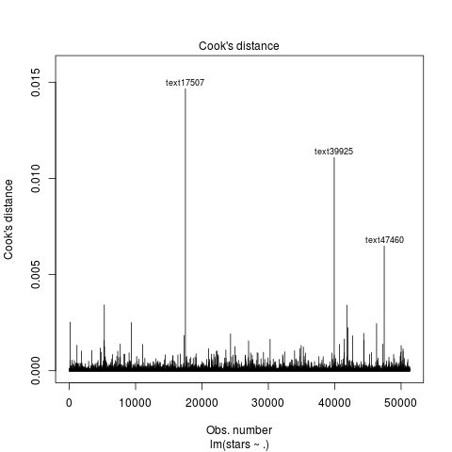
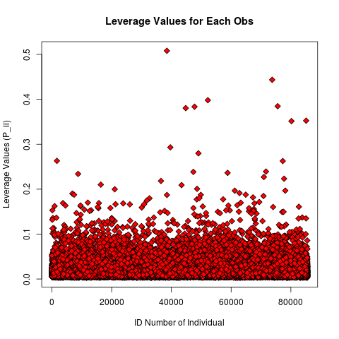
Leverage Points
Notes:
Outliers in X leverage point. Although there is one point with high leverage point, all of them have low cook’s distance, and we have too many predictors.

Slide 18
Rule of Thumb
1 * TF-IDF(“kind”)
Cautions:
Our MLR model only explains 66.08% of variance
Only based on reviews in Wisconsin and English (not able to predict other area).
Not Simple (interpretability)
Not Robust (could be < 1 or > 5).
Notes:
Difficult to interpret. Increase in TF-IDF score of “kind” would increase a star rating by 1.

Slide 19
Thank you !

